Slide 1
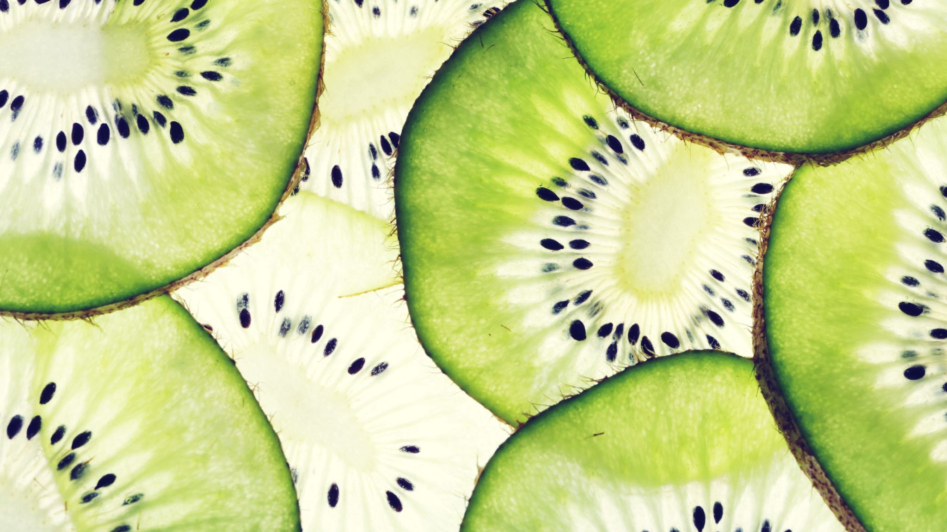
FRUIT ANALYSIS AND RECOGNITION ARTIFICAL INTELLIGENCE
GROUP 10
SENA NUR TOPAL 230610048
MUHAMMED EMİR BAKTAŞ 230610024
ALİ DEMİRTAŞ 230610026

Slide 2
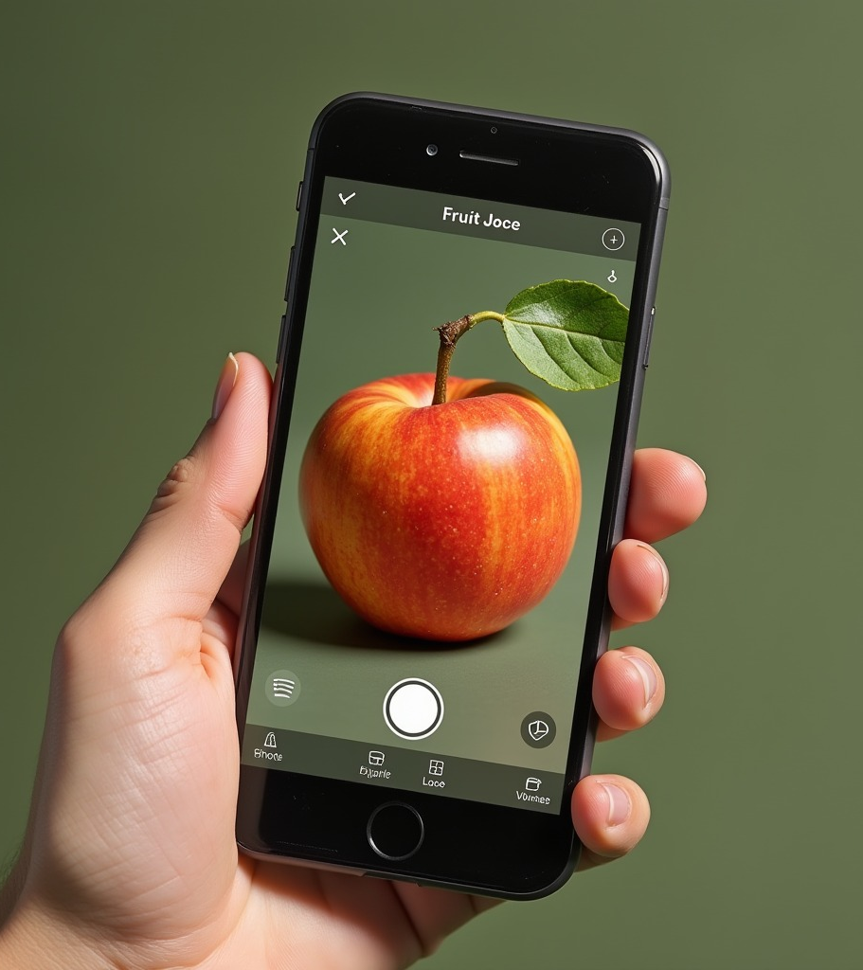
PROJECT OBJECTIVE
To develop an artificial intelligence system capable of identifying fruit types from visual data and providing information such as nutritional values about the identified fruits. Main purpose is when we shown us a picture of a fruit it will recognize and analyse this fruit ( for example when we go to a market and if we want to know about what is this fruit, we can know with this artifical intelligence )

Slide 3
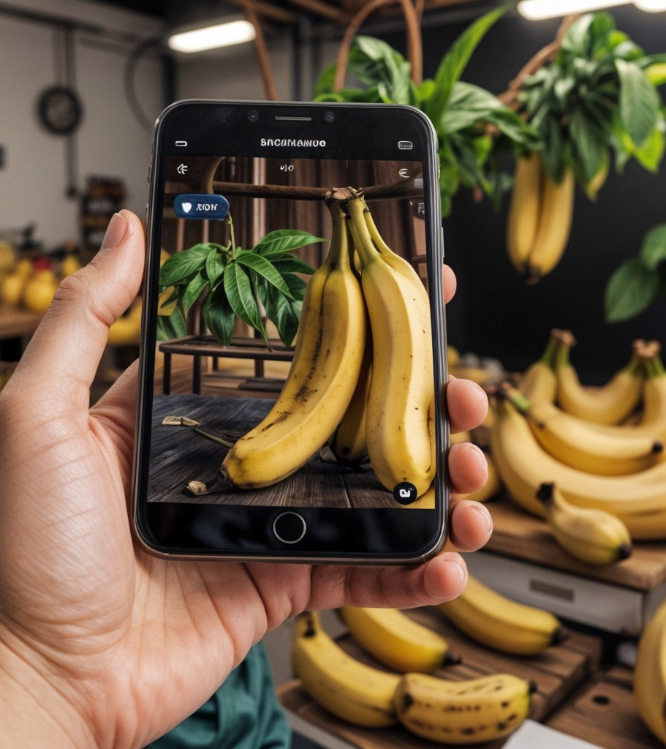
KEY STEPS OF THE PROJECT
Data Collection: Using open-source datasets for fruit images (e.g., Kaggle).
Data Processing: Resizing, normalizing, and converting images into the appropriate format.
Model Training: Training a CNN-based model using TensorFlow and Keras.
Model Testing: Analyzing accuracy rates and making improvements.
Result Presentation: Developing a user-friendly interface.
Fruit Recognition: Identifying fruit types from images.
Information Delivery: Providing brief details about the recognized fruit (e.g., calorie content, vitamins).

Slide 4
TECHNOLOGIES USED
Google Colab: For coding and testing.
TensorFlow/Keras: For model training.
OpenCV: For image processing.

Slide 5
OUR GITHUB ACCOUNTS
https://github.com/SENANURTOPAL
https://github.com/Emirbaktas
https://github.com/dmirtsalii25

